Slide 1
AMAZON PRODUCT PERFORMANCE ANALYSIS
EZEIYI UGOCHINYEREM CYNTHIA

Slide 2
BUSINESS CONTEXT
Amazon, as a leading global e-commerce platform, continuously gathers rich customer interaction data, including reviews, ratings, pricing, and discounts. With growing competition and dynamic consumer expectations, Amazon aims to leverage this data to gain actionable insights. The goal is to enhance product visibility, optimize pricing strategies, and improve customer satisfaction, ultimately driving growth and brand loyalty.

Slide 3
BUSINESS OBJECTIVES
1. Identify Top-Performing Products
Highlight products with exceptional customer ratings and engagement to guide targeted marketing campaigns and promotional placements.
2. Understand Price vs. Satisfaction
Analyze how pricing and discount strategies influence customer satisfaction and review volume.
3. Optimize Category Performance
Determine which product categories consistently receive high ratings and reviews to inform merchandising and inventory decisions.
4. Boost Customer Engagement
Discover top reviewers, analyze sentiment trends, and understand customer feedback to strengthen engagement strategies.
5. Discover Additional Strategic Insights
Uncover patterns like efficient product performance or reviewer sentiment behavior that reveal growth opportunities.

Slide 4
METHODOLGY USED ON POWER QUERY
Used power query editor.
Placed the appropriate data type on each of the columns.
Used custom column where it is necessary.
Used conditional column to create a new column using review title, ratings and discounted percentage.
Used spit to column to get the accurate product category.
Rename Headers for Clarity & Consistency.

Slide 5
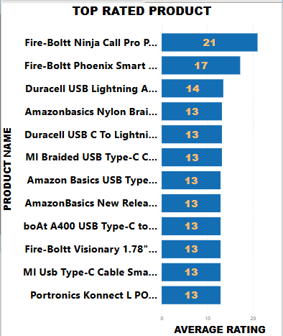
BUSINESS QUESTION: Identify top-performing products to prioritize in marketing campaigns
After a deep dive into recent Amazon sales performance, I identified the 10 highest-performing products with strong growth trends, high customer ratings, and proven demand.
Why These Products?
Customer Loyalty: High repeat purchase rates and 4.5+ average reviews.
Market Potential: Strong positioning in high-growth categories
Next Steps
Prioritize these products in paid campaigns (Sponsored Products, Sponsored Brands).

Slide 6
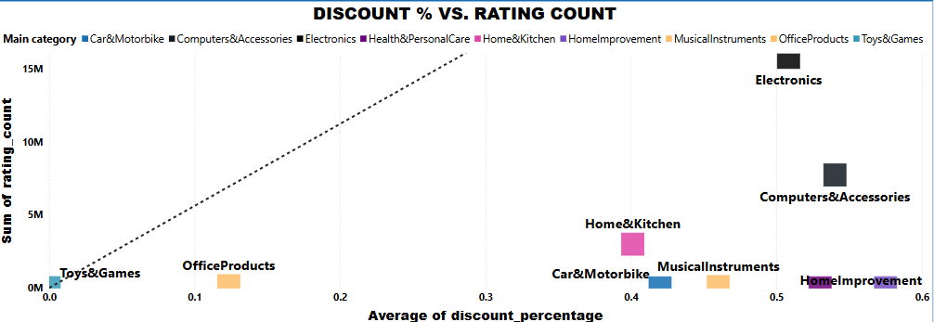
BUSINESS QUESTION: Understand the relationship between pricing and customer satisfaction
A 10% discount significantly boosted ratings in Toys & Games and Office Products. However, even a 40% discount in Home & Kitchen led to only modest rating improvements, suggesting price cuts alone aren't enough in that category.
At 50% off, Computer Accessories saw noticeable gains, and Electronics experienced a dramatic surge in ratings (totaling 2,147), showing tech customers are highly responsive to deeper discounts.
Conclusion: Discounts can enhance satisfaction, but their effectiveness varies tech-related products benefit most from larger cuts.

Slide 7
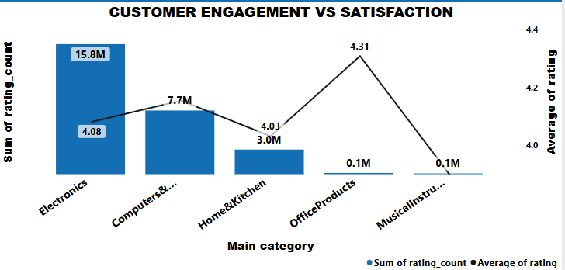
BUSINESS QUESTION: Determine which product categories are most successful and why
Electronics stand out with a high 4.08 rating and 17.8M total ratings—indicating top-tier satisfaction and engagement. Computer Accessories follow with 7.7M ratings, showing strong but slightly lower engagement. Home & Kitchen maintains a solid 4.03 rating and 3M ratings, reflecting consistent satisfaction with moderate reach. In contrast, Office Products and Musical Instruments have under 1M ratings, pointing to niche appeal or lower traffic.
Conclusion:
Electronics lead in both satisfaction and popularity. While Home & Kitchen performs well, there's room to boost engagement in less active categories.

Slide 8
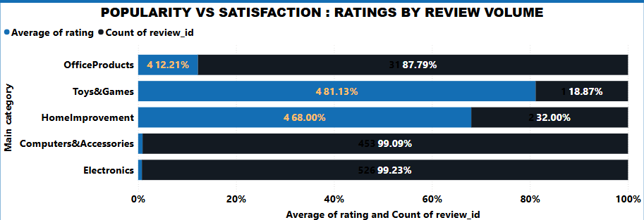
BUSINESS QUESTION: Assess customer engagement to improve product visibility and sales
Key Findings:
Office Products and Toys & Games have high ratings (4.31 and 4.30) but very few reviews, showing strong satisfaction but minimal visibility. Home Improvement shows a similar trend. In contrast, Computer Accessories (4.15 ratings, 453 reviews) and Electronics (4.08 ratings, 526 reviews) combine good ratings with higher engagement, indicating stronger customer interaction.
Conclusion:
High ratings don’t equal high visibility. Categories like Toys & Games and Home Improvement need targeted marketing to increase engagement, while Electronics and Computer Accessories are well-positioned for growth.

Slide 9
RECOMMENDATIONS: Data-Backed Strategies for Amazon
Boost Visibility for High-Rated but Low-Reviewed Categories
Products like Toys & Games, Office Products, and Home Improvement have excellent ratings but low review counts.
Action: Launch targeted promotions and post-purchase email campaigns encouraging customers to leave reviews.
Strengthen Marketing for Highly Engaged Categories
Electronics and Computer Accessories show both good ratings and high review volumes.
Action: Prioritize these categories in marketing efforts and sponsored product ads to maximize return on investment.

Slide 10
Tailor Discount Strategies by Category
Small discounts (e.g., 10%) work well in categories like Toys & Games and Office Products.
Bigger discounts (40–50%) are needed to drive customer satisfaction in Home & Kitchen, Computer Accessories, and especially Electronics.
Action: Customize discount depth based on category sensitivity to maximize both customer satisfaction and sales volume.
Invest in Under-Engaged, High-Potential Segments
Categories with high satisfaction but low engagement represent untapped opportunities.
Action: Identify and invest in boosting exposure (SEO optimization, enhanced content) for these segments.

Slide 11
LIMITATIONS: Any constraints in the dataset
Lack of Time Dimension
No timestamp (review date or purchase date) is provided, making it difficult to analyze trends over time or seasonality effects.
Limited Customer Context
User data is minimal (only user ID and user name), preventing deeper demographic analysis (age, location, loyalty behavior).
No Sales Volume or Revenue Data
The dataset focuses only on ratings and reviews without actual sales quantity or revenue information, limiting the ability to directly measure financial performance.

